Slide 1
ENTREPRENEURIAL SUPPORT ORGANIZATIONS IN THE QUADRUPLE/QUINTUPLE HELIX MODEL : AN INSTITUTIONAL PERSPECTIVE ON SOCIO-ENVIRONMENTAL ISSUES
Aveline CLOITRE, PhD Student
TBS Business School, “Entrepreneurship and Strategy” Laboratory
Toulouse School of Management, “Strategy and International management” department
a.cloitre@tbs-education.fr
Dr. Christina THEODORAKI
TBS Business School, “Entrepreneurship and Strategy Laboratory”
c.theodoraki@tbs-education.fr
Dr. Victor DOS SANTOS
TBS Business School, “Entrepreneurship and Strategy Laboratory”
v.dossantospaulino@tbs-education.fr
Notes:
First of all I am very glad to be here in Casablanca with all of you, I have the honor to begin this high quality conference. I would like to thank the organizers for giving me this opportunity.
Let me introduce myself: Aveline CLOITRE, 3rd Y PhD, in FR (south of FR, Toulouse), within the SIRIUS Chair, which the chair which supports my PhD thesis dealing with entrepreneurial dynamics in the space EE.
So let me explain all these complex words and concepts hat you see in the title of my presentation.

Slide 2
1. Introduction
Notes:
I adopt an institutional perspective on EEs, and more precisely on ESOs
So what is an EE? Very wide/broad concept which refers to the elements that we know in biology, with fauna and flora fostering life. We study the emergence, the frontiers, the components of these ecosystems, but also the complex interdependencies between all these elements.
So more or less, the same thinking applies to the actors in entrepreneurial ecosystems. There are interdependencies between all of them to foster entrepreneurial dynamics. A theory enables us to study these interdependencies, which is the institutional one, on which a lot of works rely to study EEs.

Slide 3
1. Introduction
2. Literature review
3. Method
4. Findings & discussion
Context
ESOs in EEs
Bergman and McMullen (2022)
Institutional perspective
Q/Q Helix contextualization
van Rijnsoever (2022)
→ Need for considering socio-environmental issues to foster sustainable entrepreneurial projects
Spigel (2016)
Theodoraki (2020)
→ Definition, configuration, network, relations with EE actors and strategies.
Urbano et al. (2019)
Carayannis et al. (2018)
→ Meso and macro level perspective on EEs enabling the study of ESOs interdependencies
United Nations (2015)
Lamine et al. (2021)
Context overview
Notes:
The literature on EEs has provided very relevant works on their definition, their frontiers, configurations, resources and networks. So we can conceptualize an EE as spheres, with more or less porous frontiers interacting with other EEs to foster innovation, and thus also entrepreneurship. (Ref?). These EEs are made of sub ecosystems themselves (CT). EE: heterogenous groups of actors, focused on entrepreneurial dyanmics→ among these actors: ESOs.
What are ESOs? All the organizations which aim to support entrepreneurs to conduct their entrepreneurial projects, from the ideation, incubation, acceleration phases, as well as the first fundings and contracts. (Brgam???)→ help entrepreneurs to enter the market and find a place in their EE.
But if we zoom in the various actors in EEs, we lack conceptual models to gain a better understanding of the linkages/interdependencies of these groups of actors at a meso level. Therefore we rely on the Q/Q Helix model (which provides a wider/broaden contextualization tan the Triple helix model hat some of you probably know). It is a conceptual model made of 3 core groups of actors (Industry, University Government), and 2 others spheres, the civil society (users, citizens) and the environment (natural environment, we noticed the conceptual linkage with EE approach due to the consideration of the territory of EEs). Such model Q/Q considers EEs as big spheres made of different groups of actors. Thanks to this “ZOOM”, we can study ESOs at a meso-level.
The research objective is to understand how these ESOs position themselves towards other groups of actors, and their configurations in EEs: INDUS, GOV, UNIV.
Pb→ whe do not have a good understanding of the role of ESOs within these groups of actors, as ESOs belong to all of them: GOV/INDUS, Indus,/gov indus/univ etc…
Due to the context of climate change, entrepreneurial dyamics need to be considered in EEs, so the Q/Q Helix model enables the considerations of socio-environmental issues and more especially regarding

Slide 4
1. Introduction
2. Literature review
3. Method
4. Findings & discussion
Research question
How ESOs address socio-environmental issues in EEs within the Q/Q Helix model?

Slide 5
2. Literature review
Notes:
What does the literature tell us about this problem? As I explained it, we mobilize four main elements that will each complete the conceptual model that we need to answer this question.
EE+Q/Q Helix: both rely on institutions – they bridge the gap between them. Focus on ESOs: macro-level as we study EE global configurations, and meso-level as we focus on ESOs and their enlarged business configurations – their interactions with other EE actors which take place at a macro-meso level.

Slide 6
1. Introduction
2. Literature review
3. Method
4. Findings & discussion
Institutional theory
North (1991)
Lamine et al. (2021)
Ecosystem approach
ESOs in EEs
Audretsch et al. (2019)
Theodoraki et al. (2021)
Q/Q Helix model
Carayannis et al. (2018)
Lamine et al. (2021)
Theoretical interest
EEs and the Q/Q Helix literatures: theoretical gap between these two complementary approaches
Institutions enable researchers to fill the gap between these two approaches - macro/meso levels
Spigel (2016)
Literature review overview
Notes:
High-technological EEs in their emerging phase – how they are structured
Over the past ten years – acceleration of the commercialization of space activities with a number of start-ups which increases fivefold in a decade → socio-environeemntal impacts of space activities.
Mulpitpliation of ESOs
FR: space power (access to space thanks to launching capabilities)
Various incentives implemented by the French space agencies
Providing a better understanding of ESOs role within the Q/Q helix model by focusing on institutions when socio-environmental issues appear in EEs

Slide 7
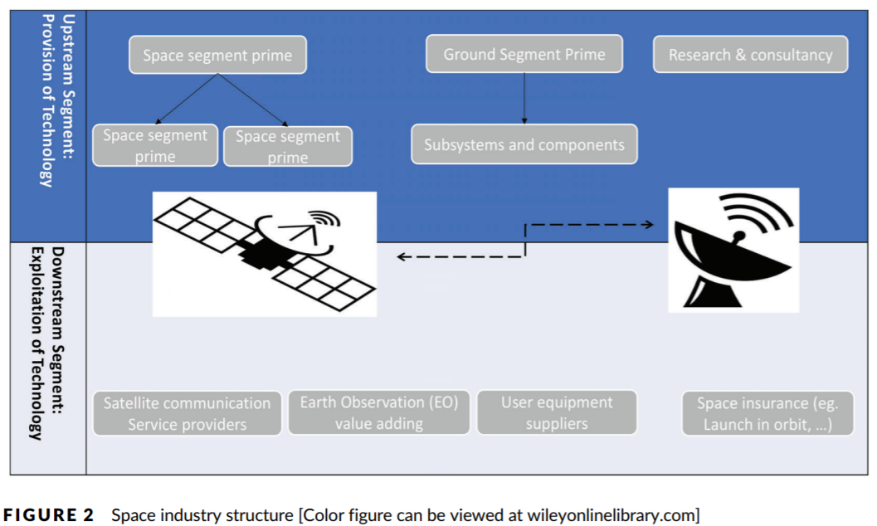
1. Introduction
2. Literature review
3. Method
4. Findings & discussion
The space EE
Emerging EE – high-technological sector (Roundy et al., 2018)
Acceleration of space activities’ commercialization
Number of start-ups X5 in a decade
Increasing number of ESOs in Europe, France
UN (2015): « Space for all » SDG
Source: Lamine et al. (2021)
Notes:
several created start-ups that increased nearly fivefold over a 10-year span

Slide 8
3. Method

Slide 9
1. Introduction
2. Literature review
3. Method
4. Findings & discussion
Research design
Exploratory qualitative study – primary data (2021-2022, ~ 1h00)
Rigorous method given by Gioia et al. (2013)
French space EE as case study
Data collection & analysis
Semi-structured interviews / Thematic data analysis on Nvivo (still in process) - Lamine et al., (2021)
Categories of interviewees | ESOs | Government | Industry | Start-ups | TOTAL
Number of interviews | 10 | 13 | 6 | 12 | 41
Duration | 11h06min42s | 13h39min43s | 05h20min15s | 10h52min15s | 40h58min55s
Data collection
Notes:
Main conceptual objective: To deepen the findings on ESOs’ role in EEs by contextualizing them within the Q/Q Helix model on EEs by focusing on the dynamic interplay of institutional factors shaping the entrepreneurial dynamics of the space ecosystem as an illustrative case study.
We aim to study the institutional interdependencies of the various actors involved in ESOs activities by relying on the influence of the institutional environment has on entrepreneurial practices
→ Stakeholders involved in the entrepreneurial support process by selecting ESOs helping start-ups in the French space EE to emerge

Slide 10
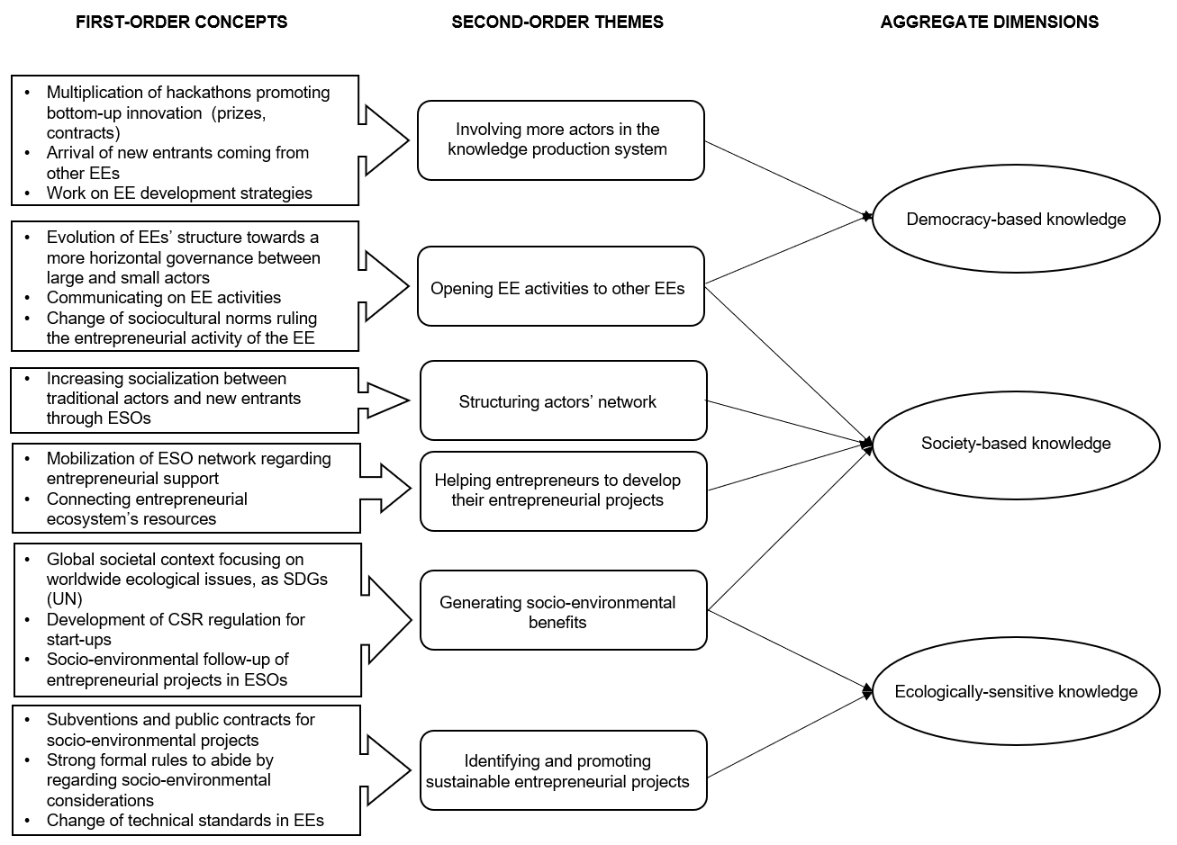
1. Introduction
2. Literature review
3. Method
4. Findings & discussion
Data structure
Notes:
Different types of knowledge production in ESOs:
- Democracy-based
- Society-based
- Ecologically-sensitive

Slide 11
4. Findings & discussion

Slide 12
1. Introduction
2. Literature review
3. Method
4. Findings & discussion
Findings
FSEEPS (Friendly Socio-Environmental Entrepreneurial Projects) = ESOs’ ultimate goal regarding socio-environmental issues
Society-based knowledge production
Public policies promoting more inclusive governance in ESOs
Socialization between ESO members
Democracy-based knowledge production
New socio-cultural norms towards horizontal governance
Evolution of ESO structures to foster bottom-up innovation
Ecologically-sensitive knowledge production
Worldwide climate change
Impacts on the geographical area of ESOs and/or their FSEEPs
Macro-level
Meso-level
FSEEPs development

Slide 13
1. Introduction
2. Literature review
3. Method
4. Findings & discussion
Discussion
Conceptual implications:
ESOs → FSEEPs
ESOs highlight EE dysfunctions regarding socio-environmental issues
Empirical implications:
Crucial role played by ESOs when promoting entrepreneurial projects as outcomes for EEs → few means to evaluate these outcomes for EEs
Limits and further research: One case study, need for tools to measure ESOs outcomes → Need to deepen this research on ESOs’ outcomes for EEs through the Q/Q Helix model
Notes:
We showed that ESOs are interconnected with the five helix of the Q/Q Helix model and act as innovation catalysts, monitors and promoters of the Mode 3 of the knowledge production system by 3

Slide 14
Thank you! Questions, comments?

