Slide 1
WHAT NEXT FOR THE NATIONAL AGENCIES ?
pradels@aerospace-valley.com

Slide 2
ECONOMY OF THE SPACE SECTOR
From the space race to the conquest of the space sector.

Slide 3
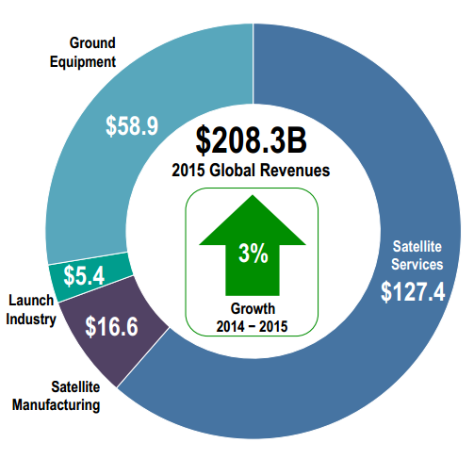
SPACE MARKET
Telecom as dominant marquet
Télécom ~ $148 B
2/3rd of the global revenues
Source: Tauri Group

Slide 4
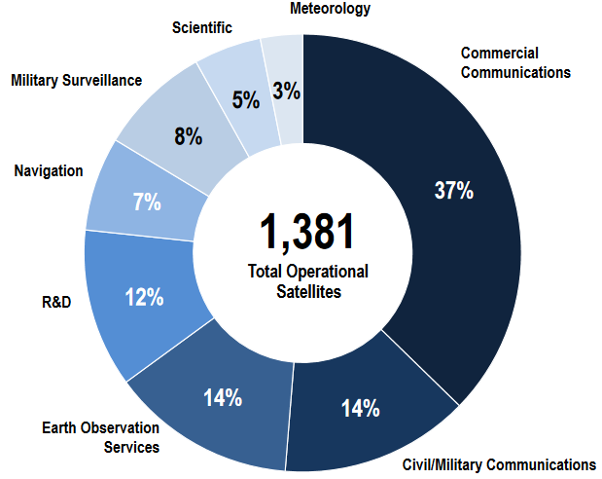
SPACE SATELLITES
Fulfiled by public missions
31/12/2015
Source Tauri Group

Slide 5


CNES & INDUSTRIES PROGRAMS
 | Launcher
 | Science
 | Observation
 | Telecom & Nav
 | Defence
 | AOB

Slide 6


CONCLUSION
Innovation = technical development
Spatial sector = reserved to public authority
Innovation
Business
development
Space industry
Mature on any domains
What next for the national agencies ?

Slide 7
INNOVATION THEORIES
Release a pain to innovate.

Slide 8

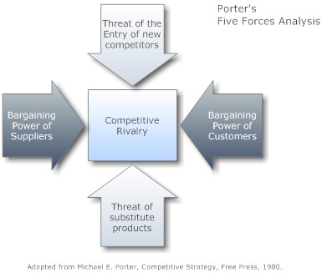
M. PORTER MODEL
Incremental Innocation
Harvard Business School
LOW COST
or
DIFFERENTIATION

Slide 9


C. CHRISTENSEN MODEL
Disruptive Innovation
Harvard Business School
Leaders are challenged by new incomers, developping proposals far away from their model:
Ressources
Processus
Values
are too differents. This situation requires to develop new independent entity.

Slide 10

ECOSYSTEME
Traditional approach is based on one single customer and long term project

Slide 11

ECOSYSTEME
capital, know-how, compétition
“ Rivals compete intensely to win and retain customers….
… competition depends on productivity, not on access to inputs…” M. PORTER
Passer de la conquête de l’espace à celle du spatial

Slide 12
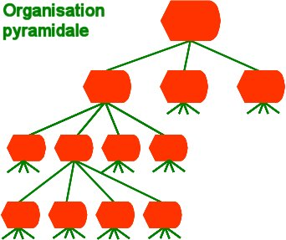
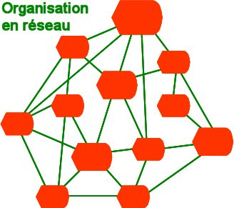
Evolution in the management
VS
CAREER
ACCOMPLISHMENT

Slide 13
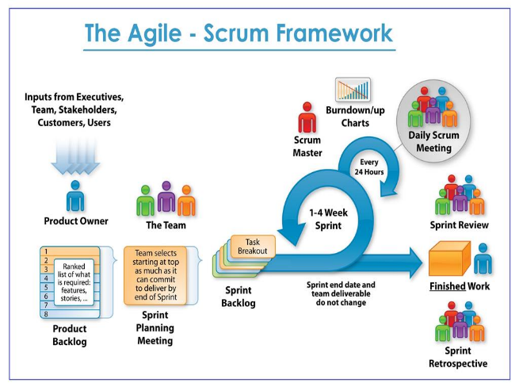
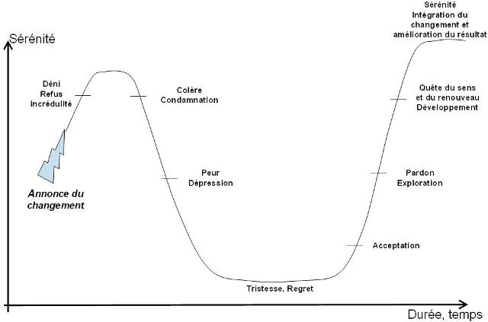

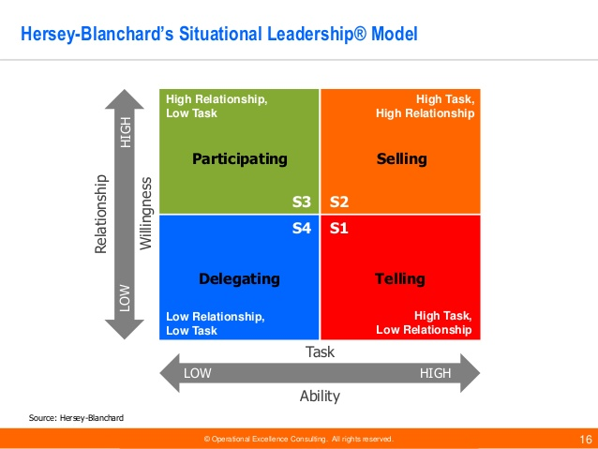
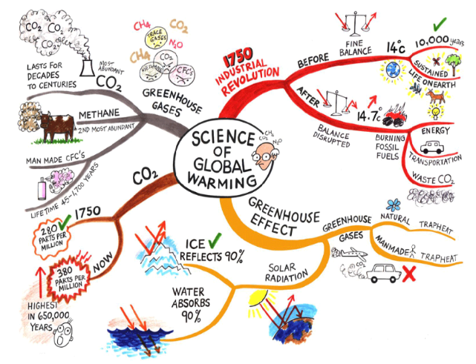
Evolution of mindset
Focus sur les besoins internes Focus sur les besoins externes
€
Performance
Time

Slide 14
ANALYSE DE SPACE X
BORN TO BE WILD

Slide 15

COTS
PROGRAMME
« Buy a ticket, not a flight »
«NOT a procurement or contract for products and services”
Be a client but not the only one → work on the business model

Slide 16
4.
ANALYSE DES CUBESATS
De nouveaux consommateurs ?

Slide 17
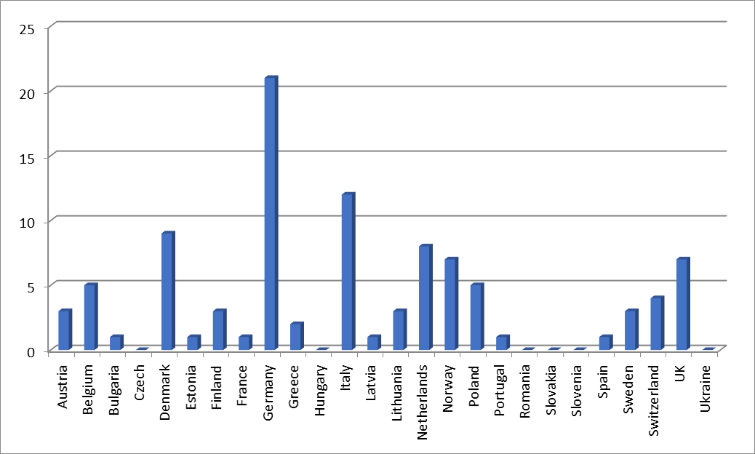
2001 – 2016: EUROPEAN STATISTIC

Slide 18
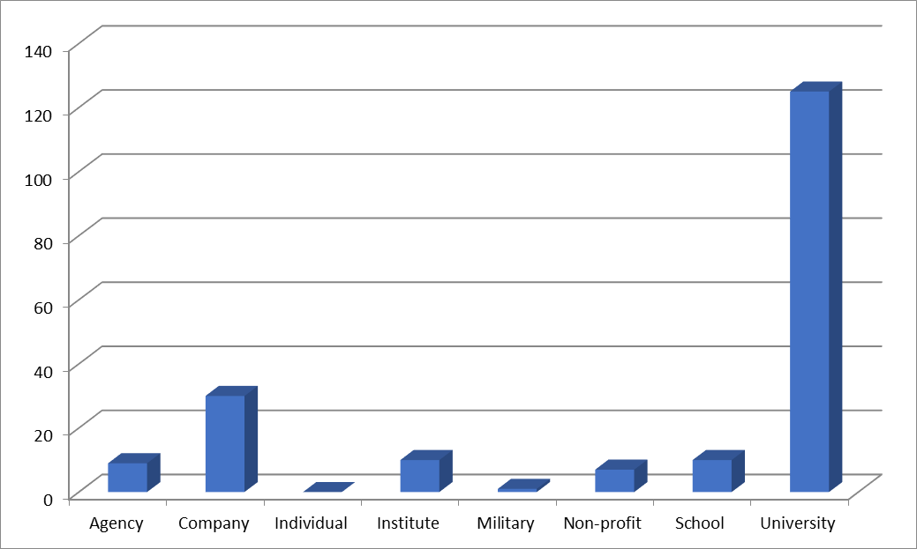
2001 – 2016 : CUSTOMERS
30US
12US

Slide 19


Slide 20
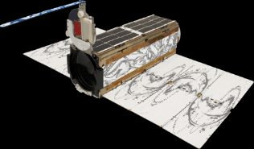
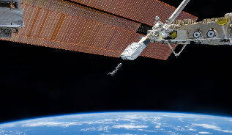
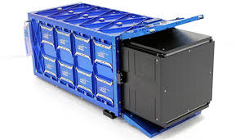

POWERFUL STANDARD

Slide 21
C. CHRISTENSEN MODEL APPLIED TO SPACE SECTOR
UNDERSHOT CUSTOMERS
Incremental Innovation
ADS, CNES, TAS
Performance
Technology
OVERSHOOT
Business Model Innovation
SPACE X
Demand of the customers
New performance
NEW CUSTOMERS
Disruptive Innovation
CUBESAT
Time
Time

Slide 22

G. PRADELS MODEL
Expert Dilemma
To fight failures, the public authority invests on the technical performance first, but can let the ecosystem develops new business models.
Request for a service and not only for a price
Be one customer but not the only one
Public project
Technical performance focus
STEPS
SERVICES
COMPETITION
Indus1 Indus2 …
Business model focus
PRODUCts
SERVICES
OTHER CUSTOMERS

Slide 23

CONCLUSION
CREATE THE FUTUR
&
STIMULATE THE PRESENT
pradels@aerospace-valley.com
www.linkedin.com/in/gpradels

