Slide 1


CIFEPME Conference – Doctoral consortium – October 2022
PhD Thesis:
ENTREPRENEURIAL DYNAMICS IN THE SPACE ECOSYSTEM
Les dynamiques entrepreneuriales dans l’écosystème spatial
Phd Student Aveline CLOITRE, PhD Student TBS Business School, “Entrepreneurship and Strategy” Laboratory Toulouse School of Management, “Strategy and International management” department a.cloitre@tbs-education.fr | PhD Supervisors Dr. Victor DOS SANTOS (HDR) TBS Business School, “Entrepreneurship and Strategy Laboratory” v.dossantospaulino@tbs-education.fr Dr. Christina THEODORAKI TBS Business School, “Entrepreneurship and Strategy Laboratory” c.theodoraki@tbs-education.fr

Slide 2
Aveline CLOITRE
PhD Thesis: ENTREPRENEURIAL DYNAMICS IN THE SPACE ECOSYSTEM
Doctoral consortium
CIFEPME Conference, October 2022
1. Research objectives

Slide 3
Aveline CLOITRE
PhD Thesis: ENTREPRENEURIAL DYNAMICS IN THE SPACE ECOSYSTEM
Doctoral consortium
CIFEPME Conference, October 2022
    Context
    EEs → increasing theoretical interest since the mid-2010s
    Emerging EEs undergo major sociotechnological transformations
    Little knowledge on ESOs’ role in emerging EEs and their outcomes for EEs
Theoretical interest
EE elements overview from an institutional perspective Audretsch et al. (2019)
Institutions shape the entrepreneurial dynamics in emerging EEs Lamine et al. (2021)
ESOs/Sustainable developement of start-ups in EEs van Rijnsoever, F. J. (2022)
    PhD thesis positionning
1. Research objectives
2. Literature review
3. Method
4. Progress

Slide 4
Aveline CLOITRE
PhD Thesis: ENTREPRENEURIAL DYNAMICS IN THE SPACE ECOSYSTEM
Doctoral consortium
CIFEPME Conference, October 2022
    Research question
    How do institutions shape the entrepreneurial dynamics in emerging EEs through ESOs?
1. Research objectives
2. Literature review
3. Method
4. Progress
Notes:
To have a better understanding of entrepreneurial dynamics in emerging entrepreneurial ecosystems, such as the space one

Slide 5
Aveline CLOITRE
PhD Thesis: ENTREPRENEURIAL DYNAMICS IN THE SPACE ECOSYSTEM
Doctoral consortium
CIFEPME Conference, October 2022
What are the ecosystem outcomes provided by ESOs in emerging EEs?
How do the spheres of the Q/Q helix interplay with each other in EEs through sociotechnological transformations?
How do ESOs address socio-environmental issues in EEs within the Q/Q Helix model?
    Main research questions
    Research questions of the PhD thesis
1. Research objectives
2. Literature review
3. Method
4. Progress

Slide 6
Aveline CLOITRE
PhD Thesis: ENTREPRENEURIAL DYNAMICS IN THE SPACE ECOSYSTEM
Doctoral consortium
CIFEPME Conference, October 2022
2. Literature review

Slide 7
Aveline CLOITRE
PhD Thesis: ENTREPRENEURIAL DYNAMICS IN THE SPACE ECOSYSTEM
Doctoral consortium
CIFEPME Conference, October 2022
EEs
Audretsch et al. (2019)
Institutional theory
North (1991)
Theodoraki et al. (2021)
Lamine et al. (2021)
    Institutional perspective on EEs
Diversity of ESOs aim to foster entrepreneurship and connect all other EE institutions
Wide range of institutional settings that influence the entrepreneurial dynamics of EEs (i.e. resources, competitiveness, suppliers, consumers, and politics)
Six institutions that formally or informally shape space entrepreneurship
    Literature review of the PhD thesis
1. Research objectives
2. Literature review
3. Method
4. Progress

Slide 8
Aveline CLOITRE
PhD Thesis: ENTREPRENEURIAL DYNAMICS IN THE SPACE ECOSYSTEM
Doctoral consortium
CIFEPME Conference, October 2022
EEs
Audretsch et al. (2019)
Institutional theory
North (1991)
Q/Q Helix model
Carayannis et al. (2018)
Theodoraki et al. (2021)
Lamine et al. (2021)
    EEs as helix
EEs and the Q/Q Helix literatures: theoretical gap between these two complementary approaches
Q/Q Helix : contextualization of institutional interdependencies of EEs (macro level), and their groups of actors
Institutions enable researchers to fill the gap between these two approaches – macro/meso levels
    Literature review of the PhD thesis
1. Research objectives
2. Literature review
3. Method
4. Progress

Slide 9
Aveline CLOITRE
PhD Thesis: ENTREPRENEURIAL DYNAMICS IN THE SPACE ECOSYSTEM
Doctoral consortium
CIFEPME Conference, October 2022
EEs
Audretsch et al. (2019)
Institutional theory
North (1991)
Q/Q Helix model
Carayannis et al. (2018)
ESOs
Bergman and McMullen (2022)
Theodoraki et al. (2021)
Lamine et al. (2021)
Spigel (2016)
Theodoraki (2020)
    ESOs in EEs
ESOs play a major role in fostering entrepreneurial dynamics in EEs, especially during their emergence phase
Better understanding of ESOs’ role within the Q/Q helix model by focusing on institutions when socio-environmental issues appear in EEs
    Literature review of the PhD thesis
1. Research objectives
2. Literature review
3. Method
4. Progress

Slide 10
Aveline CLOITRE
PhD Thesis: ENTREPRENEURIAL DYNAMICS IN THE SPACE ECOSYSTEM
Doctoral consortium
CIFEPME Conference, October 2022
EEs
Audretsch et al. (2019)
Institutional theory
North (1991)
Q/Q Helix model
Carayannis et al. (2018)
ESOs
Bergman and McMullen (2022)
Theodoraki et al. (2021)
Lamine et al. (2021)
Spigel (2016)
Theodoraki (2020)
EEs
Institutions
Q/Q Helix model
ESOs
    Understanding of entrepreneurial dynamics in emerging EEs through ESOs
    Literature review of the PhD thesis
1. Research objectives
2. Literature review
3. Method
4. Progress

Slide 11
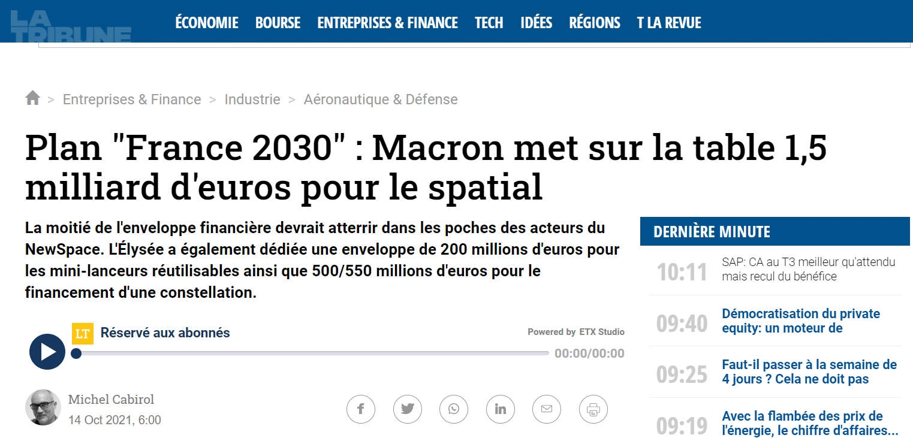
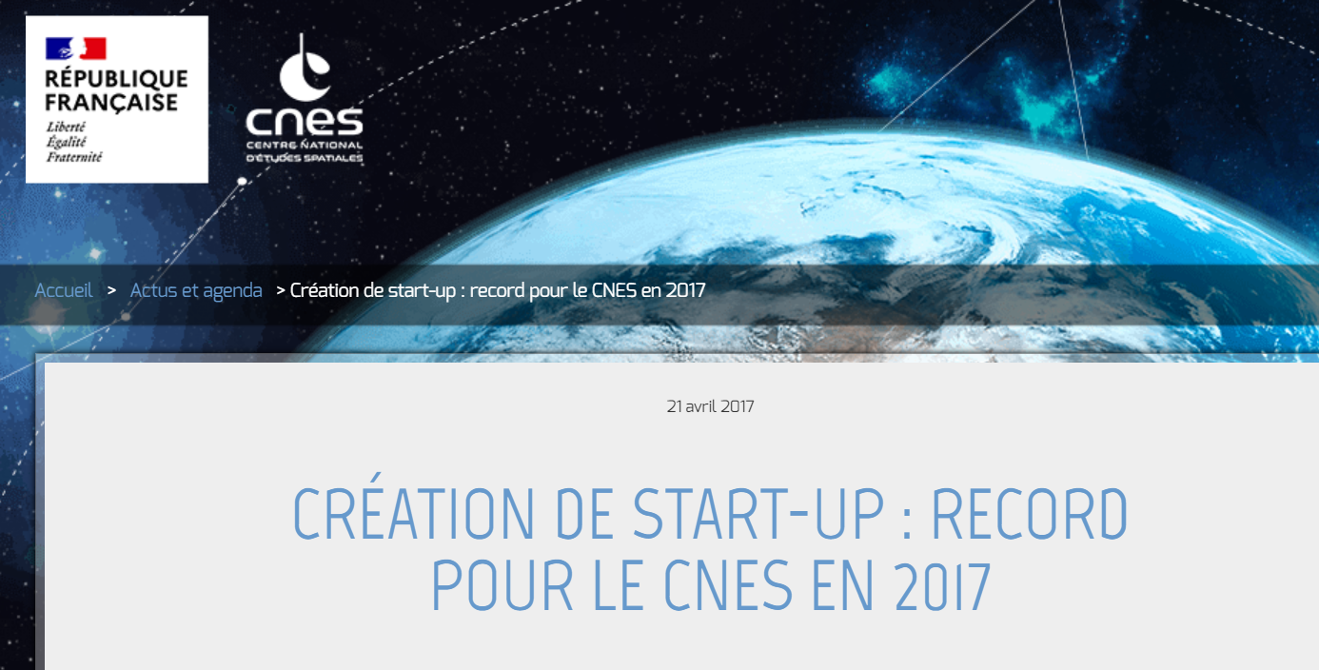
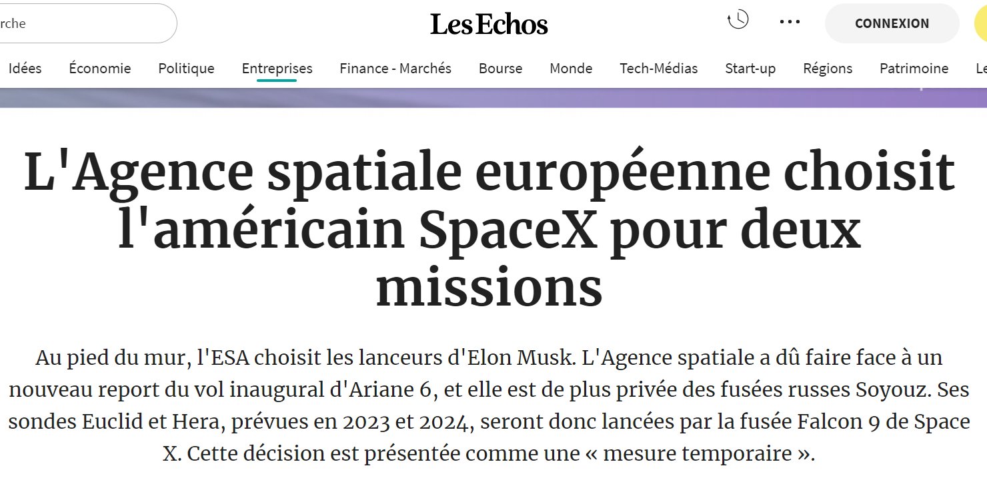

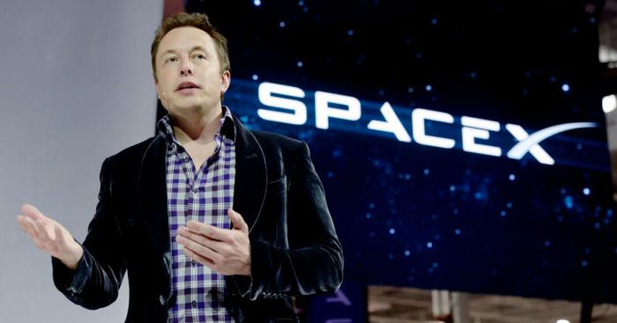
Aveline CLOITRE
PhD Thesis: ENTREPRENEURIAL DYNAMICS IN THE SPACE ECOSYSTEM
Doctoral consortium
CIFEPME Conference, October 2022
    Empirical interest
    Source: OCDE, The Space Economy in figures (20219)
1. Research objectives
2. Literature review
3. Method
4. Progress

Slide 12
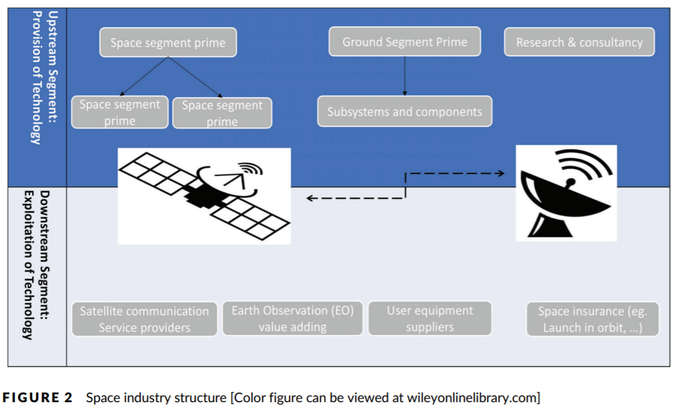
Aveline CLOITRE
PhD Thesis: ENTREPRENEURIAL DYNAMICS IN THE SPACE ECOSYSTEM
Doctoral consortium
CIFEPME Conference, October 2022
    The space EE - Structure
    Acceleration of space activities’ commercialization
    Governments’ budget increase to support space activities and value creation
    Source: Lamine et al. (2021)
1. Research objectives
2. Literature review
3. Method
4. Progress

Slide 13




Aveline CLOITRE
PhD Thesis: ENTREPRENEURIAL DYNAMICS IN THE SPACE ECOSYSTEM
Doctoral consortium
CIFEPME Conference, October 2022
    The space EE - ESOs
    Source: Lamine et al. (2021)
1. Research objectives
2. Literature review
3. Method
4. Progress

Slide 14
Aveline CLOITRE
PhD Thesis: ENTREPRENEURIAL DYNAMICS IN THE SPACE ECOSYSTEM
Doctoral consortium
CIFEPME Conference, October 2022
3. Method

Slide 15
Aveline CLOITRE
PhD Thesis: ENTREPRENEURIAL DYNAMICS IN THE SPACE ECOSYSTEM
Doctoral consortium
CIFEPME Conference, October 2022
    Research design
    Type of method: Exploratory qualitative study
    Level analysis: meso/macro-levels - EEs as a structure of actors/Groups of actors in EEs: ESOs, Government, Industry, Start-ups (Bergman and McMullen, 2022; Carayannis et al., 2018)
    Case study (space EE)
    Location: French(-European) space EE
    Selection criteria: Interviewees involved in the space entrepreneurial support process:
1. Research objectives
2. Literature review
3. Method
4. Progress

Slide 16
Aveline CLOITRE
PhD Thesis: ENTREPRENEURIAL DYNAMICS IN THE SPACE ECOSYSTEM
Doctoral consortium
CIFEPME Conference, October 2022
Primary data
41 Semi-structured interviews
Secondary data
80 space-oriented journals (peer-reviewed)
Primary+secondary data
Master’thesis data (semi-structured interviews+CNES archives)
Observation 4 local, national and international events from 2020 to 2022
Targeted interviewees’ websites, reports and press releases
    Data collection
    Methodological need for extending data collection methods Elsahn et al. (2020)
    Data triangulation (Yin, 2009)
    Data collection of the PhD thesis
1. Research objectives
2. Literature review
3. Method
4. Progress
Notes:
→ To provide pluralistic ways of studying technological and innovation concepts

Slide 17
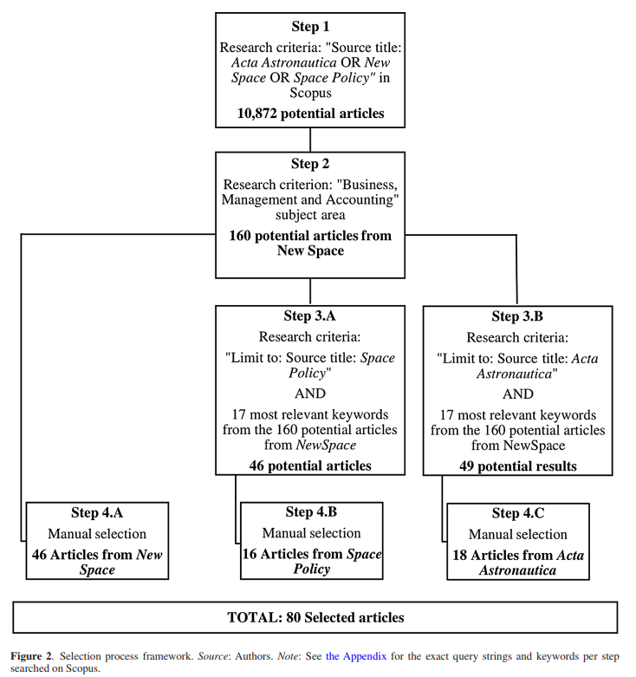
Aveline CLOITRE
PhD Thesis: ENTREPRENEURIAL DYNAMICS IN THE SPACE ECOSYSTEM
Doctoral consortium
CIFEPME Conference, October 2022
    Data collection
    Data collection – Secondary data
    Data collection – Secondary data
1. Research objectives
2. Literature review
3. Method
4. Progress

Slide 18
Aveline CLOITRE
PhD Thesis: ENTREPRENEURIAL DYNAMICS IN THE SPACE ECOSYSTEM
Doctoral consortium
CIFEPME Conference, October 2022
    Data collection
    4 categories of interviewees (Bergman and McMullen, 2022; Carayannis et al., 2018)
    Fully transcribed
Categories of interviewees | ESOs | Government | Industry | Start-ups | TOTAL
Number of interviews | 10 | 13 | 6 | 12 | 41
Duration | 11h06min42s | 13h39min43s | 05h20min15s | 10h52min15s | 40h58min55s
    Data collection – Primary data
1. Research objectives
2. Literature review
3. Method
4. Progress

Slide 19
Aveline CLOITRE
PhD Thesis: ENTREPRENEURIAL DYNAMICS IN THE SPACE ECOSYSTEM
Doctoral consortium
CIFEPME Conference, October 2022
    Data analysis
    Secondary data: (Manually)
    Content analysis - Fosso Wamba et al. (2013) and Pinkse et al. (2014)
    Primary data: (Nvivo)
    Thematic analysis – Gioia et al., (2013) and Lamine et al. (2021)
    Lamine et al., (2021)→ we directly began to analyze the data in an inductive manner when we collect it : Thematic data analysis on Nvivo (still in process)
1. Research objectives
2. Literature review
3. Method
4. Progress
Notes:
Content analysis: help researchers to deal with large amounts of textual data, as content analysis is useful for determining how words and word patterns are used in context → to generate categories and subcategories. → A content analysis provides interesting insights into the different spheres of the Q/Q helix model. It offers detailed descriptions of both the technological and social challenges faced by the space EE regarding the growth of its entrepreneurial dynamics since the 2010s.
In thematic analysis, the researcher systematically codes all data and then begins to organize the codes, based on some similarity, into larger and larger categories that may lead to a hierarchical structure of code -> subtheme -> theme
Thematic analysis is good for exploring patterns across qualitative data from participants and researchers often use this to analyze interviews. Themes are the overarching categories of common data across multiple participants. All textual data contained in a theme tells a story about that theme and is somehow related, representing different dimensions of a phenomenon. Thematic analysis helps researchers understand those aspects of a phenomenon that participants talk about frequently or in depth, and the ways in which those aspects of a phenomenon may be connected.

Slide 20
Aveline CLOITRE
PhD Thesis: ENTREPRENEURIAL DYNAMICS IN THE SPACE ECOSYSTEM
Doctoral consortium
CIFEPME Conference, October 2022
4. Progress

Slide 21
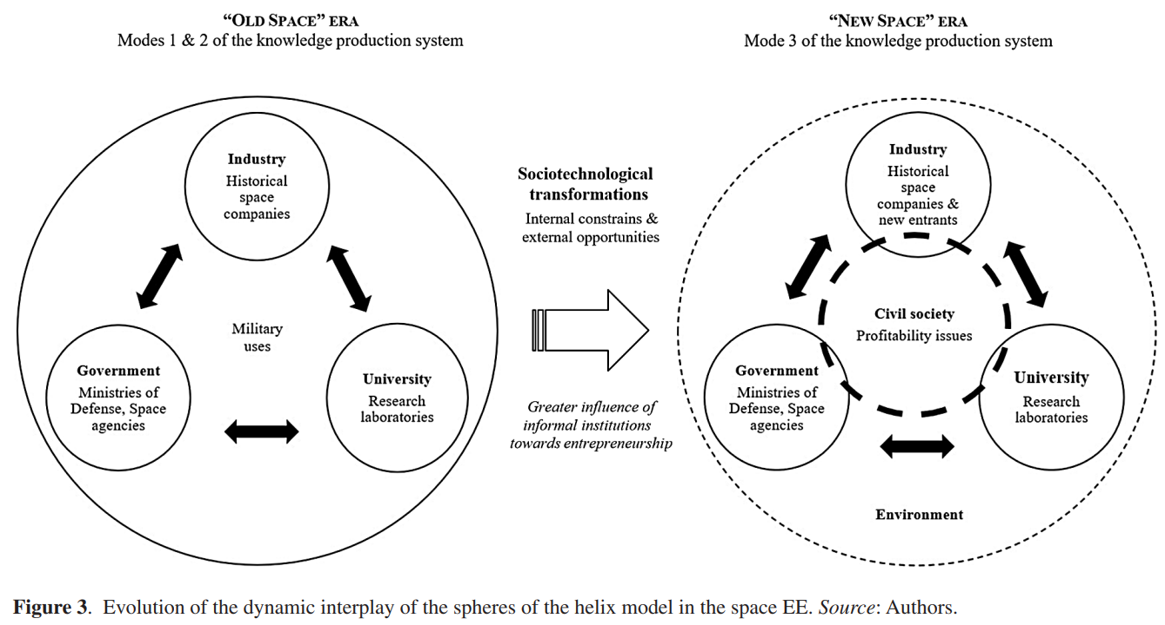
Aveline CLOITRE
PhD Thesis: ENTREPRENEURIAL DYNAMICS IN THE SPACE ECOSYSTEM
Doctoral consortium
CIFEPME Conference, October 2022
    Progress
    1st article (secondary data) – Findings – Evolution of the dynamic interplay of the sphères of the helix model in the space EE
1. Research objectives
2. Literature review
3. Method
4. Progress

Slide 22
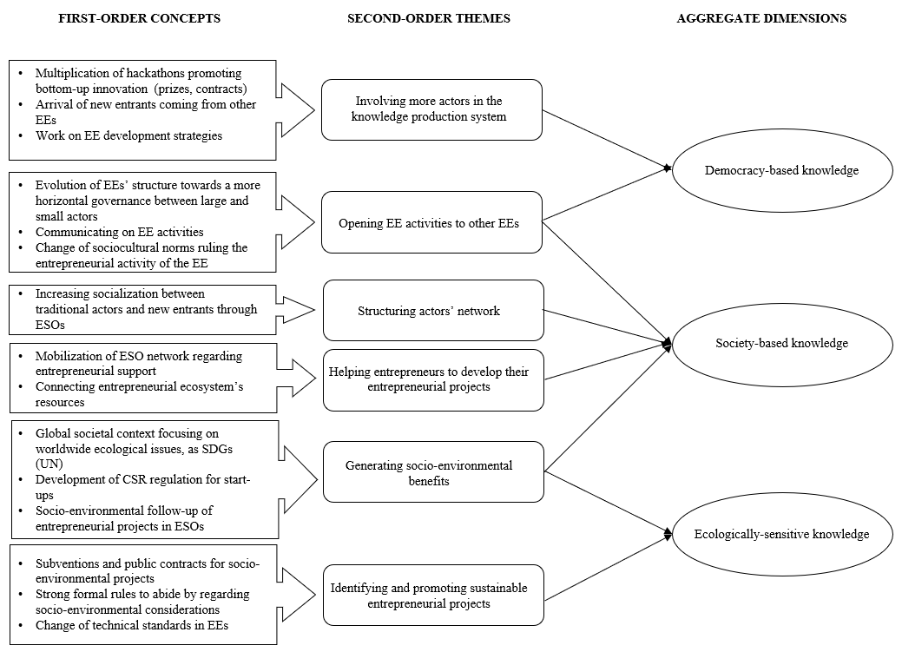
Aveline CLOITRE
PhD Thesis: ENTREPRENEURIAL DYNAMICS IN THE SPACE ECOSYSTEM
Doctoral consortium
CIFEPME Conference, October 2022
    Progress
    Data structure of the 2nd article – first « findings »
1. Research objectives
2. Literature review
3. Method
4. Progress

Slide 23
Aveline CLOITRE
PhD Thesis: ENTREPRENEURIAL DYNAMICS IN THE SPACE ECOSYSTEM
Doctoral consortium
CIFEPME Conference, October 2022
    Findings
    Theoretical contribution
    Better understanding of EE entrepreneurial dynamics through ESOs (entrepreneurial process)
    Filling the gap between the ecosystem approach and the Q/Q Helix model
    Empirical implication
    Recommendations for policy makers (CNES, Ministries) to better adapt the socio-technological transformations of the French space EE
    And for ESOs to better identify their impact for the involved organizations and territories
1. Research objectives
2. Literature review
3. Method
4. Progress

Slide 24
Aveline CLOITRE
PhD Thesis: ENTREPRENEURIAL DYNAMICS IN THE SPACE ECOSYSTEM
Doctoral consortium
CIFEPME Conference, October 2022
    Discussion & further research
    One case study (the space EE)
    Need for testing the findings (other case studies)
    Method
    Quantitative tools to measure ESOs outcomes
    Conceptual framework
    → Need to deepen this research on ESOs’ outcomes (performance?) for EEs through the Q/Q Helix model
1. Research objectives
2. Literature review
3. Method
4. Progress

Slide 25
Aveline CLOITRE
PhD Thesis: ENTREPRENEURIAL DYNAMICS IN THE SPACE ECOSYSTEM
Doctoral consortium
CIFEPME Conference, October 2022
    Progress
    1st article published in R&D Management (2 FNEGE (INNOV), Imp. Factor 5.962 (2021)) - Special issue paper “The Role of Entrepreneurial Ecosystems in Technological and Social Challenges”
    Collection of the primary data is still in process (as well as the data analysis on Nvivo )
    Currently trying to fill the gap between my two other RQ (ESOs’ role and outcomes for EEs)
    2nd paper: submission to SBEJ
    Struggling “to tell the story of PhD thesis”
1. Research objectives
2. Literature review
3. Method
4. Progress

Slide 26
Aveline CLOITRE
PhD Thesis: ENTREPRENEURIAL DYNAMICS IN THE SPACE ECOSYSTEM
Doctoral consortium
CIFEPME Conference, October 2022
    Conférences
    1st paper (2021)
    AEI, RNI, AOM Doctoral Consortium
    2nd paper (2022)
    CIFEPME (including doctoral consortium), RENT, InnoDays
    3rd paper (2023)
    EURAM?
1. Research objectives
2. Literature review
3. Method
4. Progress

Slide 27

THANK YOU!
Questions? Comments?

