Slide 1
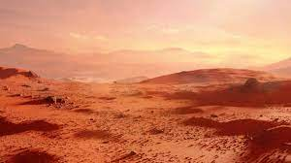
Mars Terraforming: A New Plan for the Red Planet
Presented by Nonthapat PULSIRI, PhD.
Post-doctoral researcher at TBS Business School and The Sirius Chair
Presented to PICMET Conference 2022
Portland (Oregon), The United States of America

Slide 2
Authors
1. Nonthapat PULSIRI, PhD. – Space Researcher
2. Damani A. PROCTOR, Capt. – Space Researcher
3. Richard B. CATHCART – Distinguished Geographer
4. Jorge O. BUTELER – Global Financial Advisor for Space Sector
Speaker – Dr.Nonthapat PULSIRI currently works as
Post-doctoral researcher at TBS Business School
and The Sirius Chair in France.
Ad-Astra! To The Stars! In Peace For All Mankind!

Slide 3
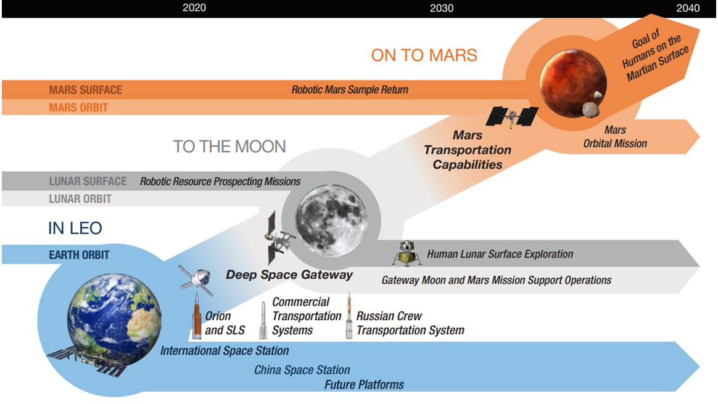
Introduction
The new habitable planet is Mars
Picture : ISECG

Slide 4
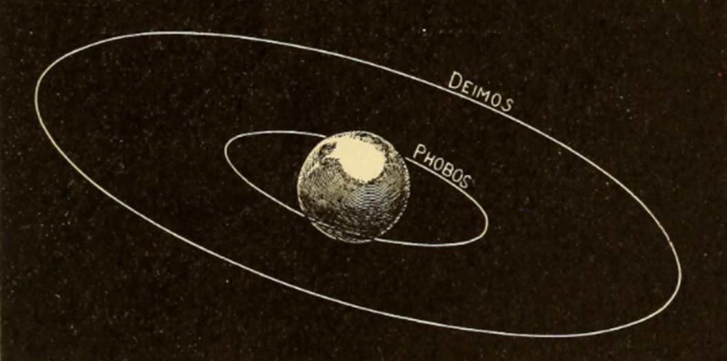
Introduction
Phobos and Deimos by Giberne
Source: Giberne

Slide 5
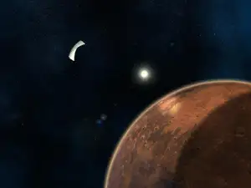
Existing Concepts
1. The Mirror Concept
Picture : newscientist

Slide 6
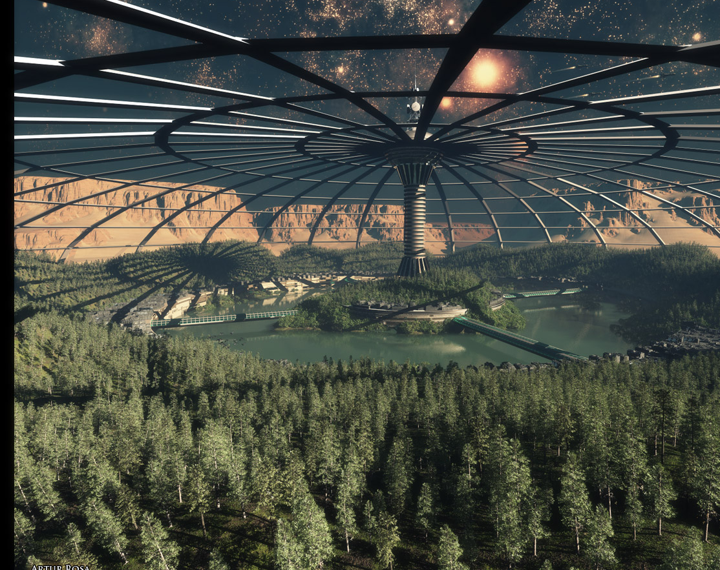
Existing Concepts
2. Increasing greenhouse gases
Picture : nextbigfuture

Slide 7
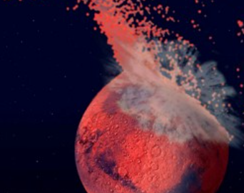
Existing Concepts
3. Bombarding with amonia-rich asteroids
Picture : scientist

Slide 8
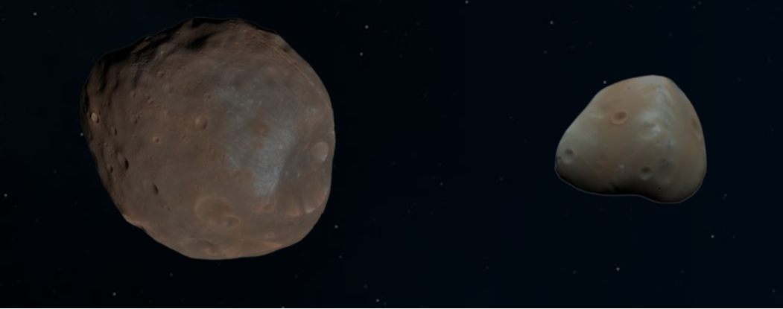
Design Stage I: Moon Stabilization
Phobos and Deimos by NASA
Picture : NASA

Slide 9
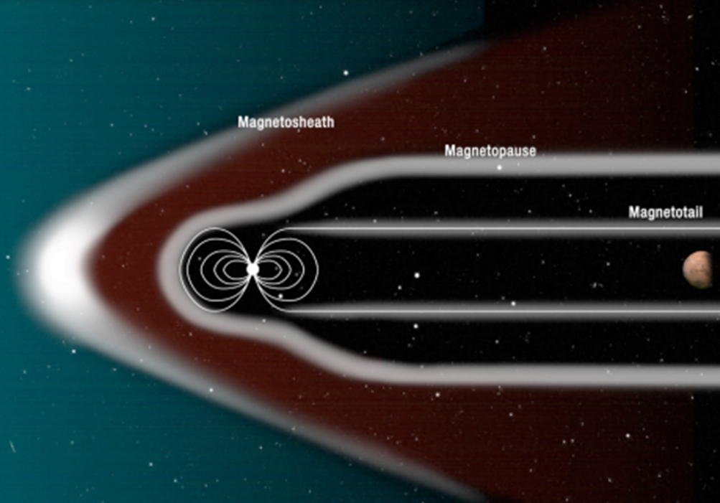
Design Stage II: Planetary Shield
Planet Protection Shield by NASA’s Chief Scientist
– Dr.James « Jim » Green
Picture : Jim Green

Slide 10
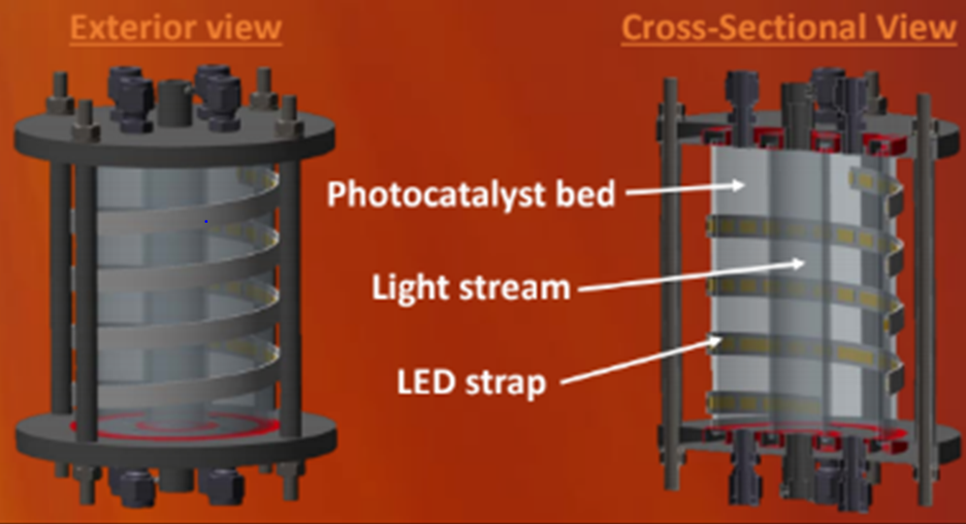
Design Stage III: Carbon Harvesting
The concept of CO2 photocatalytic conversion reactor on Mars
by NASA
Picture : NASA

Slide 11
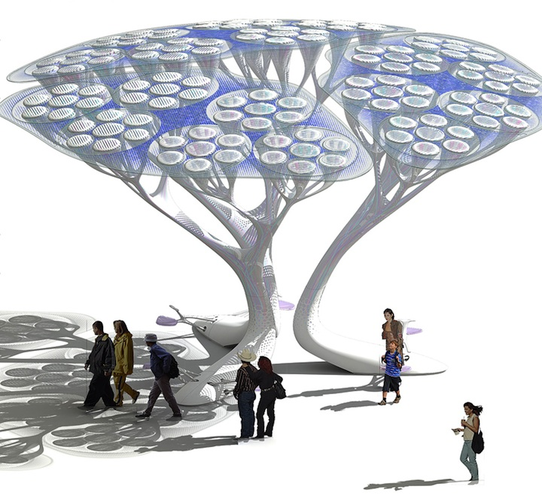
Design Stage IV: Atmospheric Conversion
The concept of Faux Trees
by Klaus Lackner
Picture : evolo

Slide 12
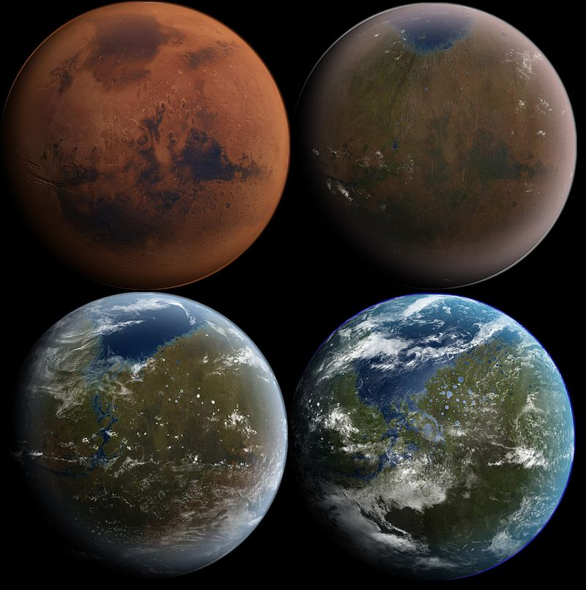
Design Stage V: Habitability
Final stage of shaping Mars’ new ecosystem as Second home
Picture : wikipedia

Slide 13
Thank You

