Slide 1


CIFEPME Conference
October 2022
The role of entrepreneurial support organizations in the Quadruple/Quintuple Helix model: An institutional perspective on socio-environmental issues
Aveline CLOITRE, PhD Student TBS Business School, “Entrepreneurship and Strategy” Laboratory Toulouse School of Management, “Strategy and International management” department a.cloitre@tbs-education.fr | Dr. Christina THEODORAKI TBS Business School, “Entrepreneurship and Strategy Laboratory” c.theodoraki@tbs-education.fr | Dr. Victor DOS SANTOS TBS Business School, “Entrepreneurship and Strategy Laboratory” v.dossantospaulino@tbs-education.fr

Slide 2
CLOITRE A., THEODORAKI C., DOS SANTOS PAULINO V.
The quadruple/quintuple helix model in entrepreneurial ecosystems: an institutional perspective on the space case study
CIFEPME Conference 2022
1. Introduction

Slide 3
CLOITRE A., THEODORAKI C., DOS SANTOS PAULINO V.
The quadruple/quintuple helix model in entrepreneurial ecosystems: an institutional perspective on the space case study
CIFEPME Conference 2022
    Context
ESOs in EEs
Bergman and McMullen (2022)
Institutional perspective
Q/Q Helix contextualization
van Rijnsoever (2022)
→ Need for considering socio-environmental issues to foster sustainable entrepreneurial projects
Spigel (2016)
Theodoraki (2020)
→ Definition, configuration, network, relations with EE actors and strategies.
Urbano et al. (2019)
Carayannis et al. (2018)
→ Meso and macro level perspective on EEs enabling the study of ESOs interdependencies
United Nations (2015)
Lamine et al. (2021)
1. Introduction
2. Literature review
3. Method
4. Findings & Discussion

Slide 4
CLOITRE A., THEODORAKI C., DOS SANTOS PAULINO V.
The quadruple/quintuple helix model in entrepreneurial ecosystems: an institutional perspective on the space case study
CIFEPME Conference 2022
    Research question
    How ESOs address socio-environmental issues in EEs within the Q/Q Helix model?
1. Introduction
2. Literature review
3. Method
4. Findings & Discussion

Slide 5
CLOITRE A., THEODORAKI C., DOS SANTOS PAULINO V.
The quadruple/quintuple helix model in entrepreneurial ecosystems: an institutional perspective on the space case study
CIFEPME Conference 2022
2. Literature review

Slide 6
CLOITRE A., THEODORAKI C., DOS SANTOS PAULINO V.
The quadruple/quintuple helix model in entrepreneurial ecosystems: an institutional perspective on the space case study
CIFEPME Conference 2022
Institutional theory
North (1991)
Lamine et al. (2021)
Ecosystem approach
ESOs in EEs
Audretsch et al. (2019)
Theodoraki et al. (2021)
Q/Q Helix model
Carayannis et al. (2018)
Lamine et al. (2021)
    Theoretical interest
EEs and the Q/Q Helix literatures: theoretical gap between these two complementary approaches
Institutions enable researchers to fill the gap between these two approaches - macro/meso levels
Spigel (2016)
    Literature review elements
1. Introduction
2. Literature review
3. Method
4. Findings & Discussion
Notes:
Providing a better understanding of ESOs role within the Q/Q helix model by focusing on institutions when socio-environmental issues appear in EEs

Slide 7
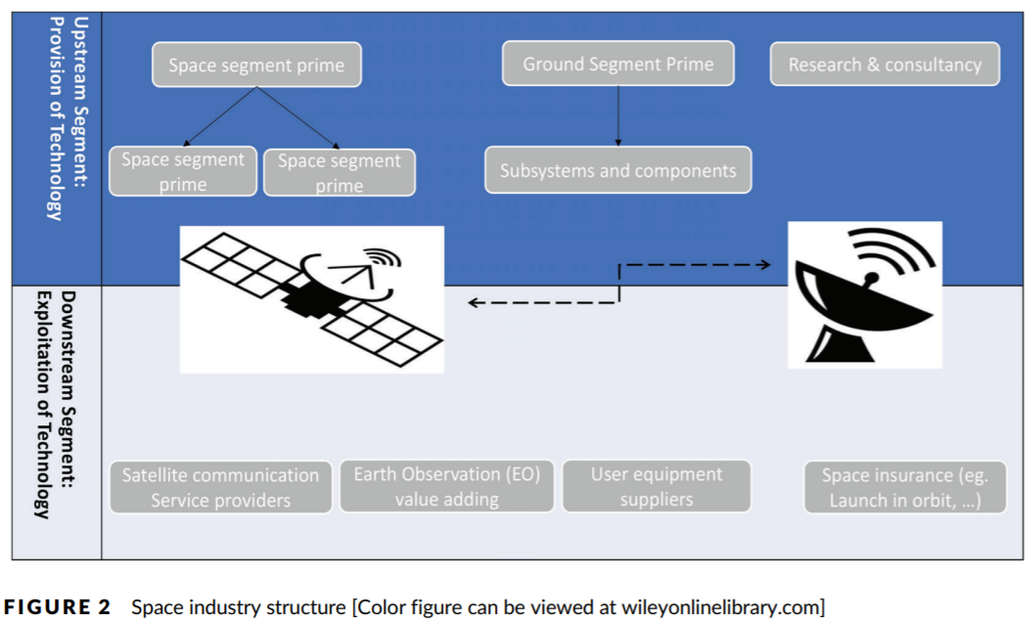
CLOITRE A., THEODORAKI C., DOS SANTOS PAULINO V.
The quadruple/quintuple helix model in entrepreneurial ecosystems: an institutional perspective on the space case study
CIFEPME Conference 2022
    The space EE - Structure
    Emerging EE – high-technological sector (Roundy et al., 2018)
    Acceleration of space activities’ commercialization
    Number of start-ups X5 in a decade
    Increasing number of ESOs in Europe, France
    UN (2015): « Space for all » SDG
    Source: Lamine et al. (2021)
1. Introduction
2. Literature review
3. Method
4. Findings & Discussion
Notes:
several created start-ups that increased nearly fivefold over a 10-year span

Slide 8
CLOITRE A., THEODORAKI C., DOS SANTOS PAULINO V.
The quadruple/quintuple helix model in entrepreneurial ecosystems: an institutional perspective on the space case study
CIFEPME Conference 2022
3. Method

Slide 9
CLOITRE A., THEODORAKI C., DOS SANTOS PAULINO V.
The quadruple/quintuple helix model in entrepreneurial ecosystems: an institutional perspective on the space case study
CIFEPME Conference 2022
    Research design
    Exploratory qualitative study – primary data (2021-2022, ~ 1h00)
    Rigorous method given by Gioia et al. (2013)
    French space EE as case study
    Data collection & analysis
    Semi-structured interviews / Thematic data analysis on Nvivo (still in process) - Lamine et al., (2021)
Categories of interviewees | ESOs | Government | Industry | Start-ups | TOTAL
Number of interviews | 10 | 13 | 6 | 12 | 41
Duration | 11h06min42s | 13h39min43s | 05h20min15s | 10h52min15s | 40h58min55s
    Data collection
1. Introduction
2. Literature review
3. Method
4. Findings & Discussion
Notes:
Main conceptual objective: To deepen the findings on ESOs’ role in EEs by contextualizing them within the Q/Q Helix model on EEs by focusing on the dynamic interplay of institutional factors shaping the entrepreneurial dynamics of the space ecosystem as an illustrative case study.
We aim to study the institutional interdependencies of the various actors involved in ESOs activities by relying on the influence of the institutional environment has on entrepreneurial practices
→ Stakeholders involved in the entrepreneurial support process by selecting ESOs helping start-ups in the French space EE to emerge

Slide 10
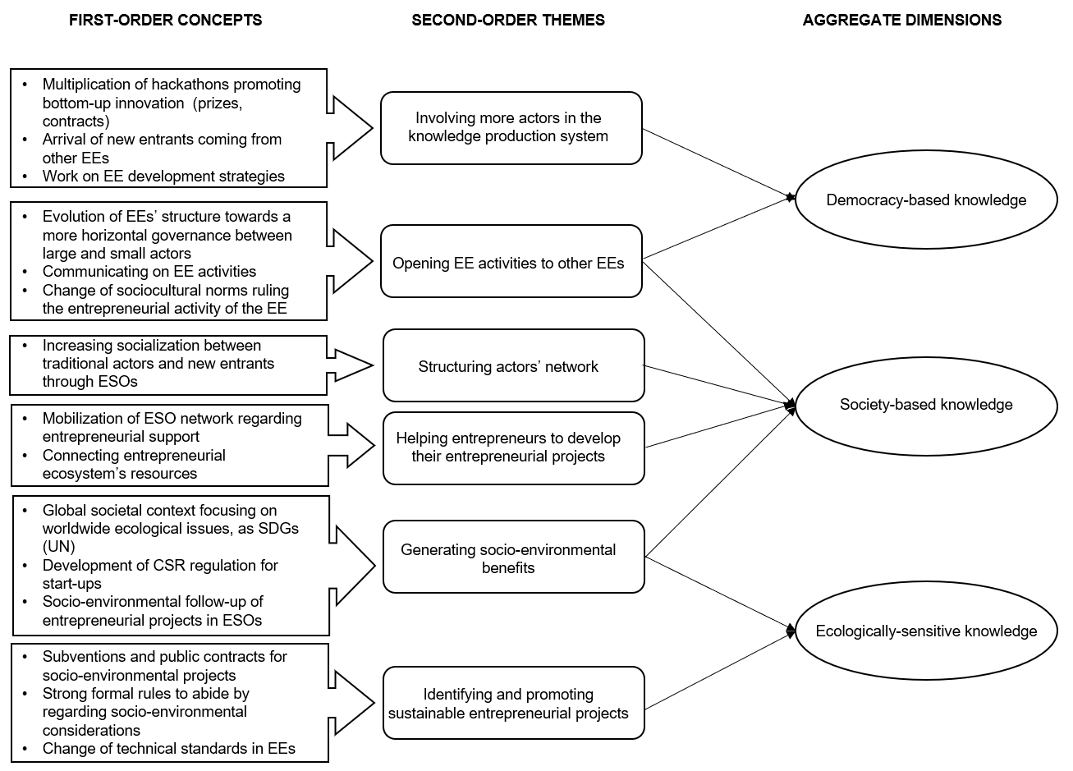
CLOITRE A., THEODORAKI C., DOS SANTOS PAULINO V.
The quadruple/quintuple helix model in entrepreneurial ecosystems: an institutional perspective on the space case study
CIFEPME Conference 2022
    Data structure
1. Introduction
2. Literature review
3. Method
4. Findings & Discussion
Notes:
Different types of knowledge production in ESOs:
- Democracy-based
- Society-based
- Ecologically-sensitive

Slide 11
CLOITRE A., THEODORAKI C., DOS SANTOS PAULINO V.
The quadruple/quintuple helix model in entrepreneurial ecosystems: an institutional perspective on the space case study
CIFEPME Conference 2022
4. Findings & Discussion

Slide 12
CLOITRE A., THEODORAKI C., DOS SANTOS PAULINO V.
The quadruple/quintuple helix model in entrepreneurial ecosystems: an institutional perspective on the space case study
CIFEPME Conference 2022
    Findings
Society-based knowledge production
Public policies promoting more inclusive governance in ESOs
Socialization between ESO members
Democracy-based knowledge production
New socio-cultural norms towards horizontal governance
Evolution of ESO structures to foster bottom-up innovation
Ecologically-sensitive knowledge production
Worlwide climate change
Impacts on the geographical area of ESOs and/or their FSEEPs
    FSEEPS (Friendly Socio-Environmental Entrepreneurial Projects) = ESOs’ ultimate goal regarding socio-environmental issues
    Macro-level
    Meso-level
FSEEPs development
    ESOs role in emerging EEs towards sustainable development
1. Introduction
2. Literature review
3. Method
4. Findings & Discussion
Notes:
We showed that ESOs are interconnected with the five helix of the Q/Q Helix model and act as innovation catalysts, monitors and promoters of the Mode 3 of the knowledge production system by 3

Slide 13
CLOITRE A., THEODORAKI C., DOS SANTOS PAULINO V.
The quadruple/quintuple helix model in entrepreneurial ecosystems: an institutional perspective on the space case study
CIFEPME Conference 2022
    Conclusion
    Conceptual implications:
    ESOs → FSEEPs
    ESOs highlight EE dysfunctions regarding socio-environmental issues
    Empirical implications:
    Crucial role played by ESOs when promoting entrepreneurial projects as outcomes for EEs → few means to evaluate these outcomes for EEs
    Limits and further research: one case study, need for tools to measure ESOs outcomes → Need to deepen this research on ESOs’ outcomes for EEs through the Q/Q Helix model
1. Introduction
2. Literature review
3. Method
4. Findings & Discussion

Slide 14

THANK YOU!
Questions? Comments?

